Slide 1
Part 1
You are logged in
The webinar will begin shortly

Slide 2
Part 1
2024

Slide 3
FYI
WhatWorkersWantStudy.com
Questions? Ask us!
This is being recorded for you to share later.

Slide 4
Why We’re Doing This
Provide intelligence for our clients to maximize research, marketing, ratings & revenue.
Provide information to help the radio industry hold on to these important listeners and grow share of listening.

Slide 5
Sample Profile
1,200 U.S. radio listeners who work full or part-time, Men and Women 18-54.
The sample is geographically balanced across the Northeast, South, Midwest and West.
All listen to local radio stations 30+ minutes per weekday for audio entertainm
The survey period is late January - early February, 2024.
There is no weighting of the data.

Slide 6
Preview of Headlines
As listening continues to shift as post-pandemic, we want to provide a clear picture of where usage patterns are today and the opportunities for radio.
There are reasons for optimism! Radio is enjoying an advantage over DSPs (Spotify, etc) in a number of areas.
Listeners perceive themselves listening more to radio than pre-COVID.
Listeners appreciate many of the unique advantages local radio offers.
Radio listening is rebounding post-COVID due to a return to higher auto use, but there are also product strengths that radio needs to leverage on top of situational use.

Slide 7
Preview of Headlines
Focus is more important than ever to maximize marketing budgets.
We identify a key segment of listeners who give the most support to radio – fulltime workers and commuters - winning and losing comes down to this portion of the audience.
Fulltime workers who commute listen more to radio, but once listeners get to their place of work, local radio is challenged. We’ll identify the people inside workplaces that radio needs to reach.
Contest participants also listen more to local radio. Contests still work!
We will provide discussion points on how you need to focus your product and marketing today.

Slide 8
Momentum
Listening More/Less compared to Pre-COVID

Slide 9
Momentum
Think about how much you listen to local radio today compared to before COVID. Would you say you are listening to local radio...
Listeners perceive themselves listening MORE to local radio today compared to pre-COVID by 2:1! (even among 18-24)
We’ll talk about why we’re not seeing this translate to ratings in Webinar 2.

Slide 10
Momentum
Think about how much you listen to local radio today compared to before COVID. Would you say you are listening to local radio...
Local radio’s momentum is strong 25-54, but one of three 18-24s feel they are listening less to radio.

Slide 11
Momentum
Which of the following are reasons why you are listening more to local radio? Select all that apply.
 | TOTAL
It’s free | 68%
It’s easy to use | 65%
It’s quick to use – just turn it on | 64%
It has local news or info about what is happening locally | 45%
There are hosts/DJs you enjoy | 35%
You discovered a new station(s) playing music you like | 34%
Each station has a focused playlist of music you like | 31%
In an age of increasing audio choice, two of the key drivers of local radio’s perceived momentum is its ease of use.
Other important drivers of momentum: Local info, personalities, discovery of a new station and singular music focus on stations in general.
Notes:
And keep in mind how many people point to information in this study comprised of music radio listeners.

Slide 12
Momentum
Which of the following are reasons why you are listening more to local radio? Select all that apply.
 | TOTAL | 18-24
It’s free | 68% | 69%
It’s easy to use | 65% | 54%
It’s quick to use – just turn it on | 64% | 74%
It has local news or info about what is happening locally | 45% | 25%
There are hosts/DJs you enjoy | 35% | 21%
You discovered a new station(s) playing music you like | 34% | 35%
Each station has a focused playlist of music you like | 31% | 18%
Among 18-24s using local radio more, the drivers are free and easy to use.
Large numbers of 18-24s also point to local, hosts and discovery of a new radio station.

Slide 13
LISTENING
MORE
LISTENING
LESS
Top Reasons:
Improved Content (20%)
Driving More (10%)
More Interest in Local Media Since COVID (10%)
Top Reasons:
More Use of DSPs (28%)
Driving In Car Less (23%)
Too Many Commercials (15%)
Less Time Now (12%)

Slide 14
Why They Are Listening MORE
Hispanic Male, 31: “I am seeing more fun segments being made by local radio personalities. With these hosts adding in their own voice. It makes these stations more fun to listen to. Because I am able to just enjoy my mornings more with good humor, jokes, and music.”
Caucasian Female, 40: “Local radio has gotten better with music choices and other content with humor and entertaining contests.”
AA Male, 32: “Because I realized that everything about it is authentic.”
Caucasian Female, 42: “We have a lot of really good local radio stations here that play a lot of music that I like. It makes driving in the car more enjoyable. Sometimes the hosts talk about funny things or interesting things.”
Hispanic Male, 50: “I discovered a radio show that got me.”

Slide 15
Why They Are Listening LESS
Caucasian Female, 20: “I just use my phone.”
Caucasian Male, 41: “Commercials are way too many. Yappa yappa yappa.”
AA Male, 32: “Sometimes the commercials are too repetitive. I realize businesses pay for airtime, but at times it’s too much of the same.”
Caucasian Female, 24: “I got to discover more of my music taste while in lockdown so I became even more picky with what I want to listen to.”
Caucasian Male, 31: “Radio would be weird if it had no commercials, I just think they need to get more creative with the commercials. Commercials used to be so much better when I was younger. But even more then that, some of these newer radio personalities are not very good anymore. It's like they just pick the first person they find.”

Slide 16
Audio Entertainment Consumption
Weekly Consumption by Age
Local Radio Listeners

Slide 17
Audio Entertainment – Weekly Consumption
Name all the different media that you listen to for audio entertainment in an average week.
(Aided)
Radio reaches nearly nine out of 10 workers on a weekly basis, but many are also using DSPs like Spotify.

Slide 18
Audio Entertainment – Weekly Consumption
Name all the different media that you listen to for audio entertainment in an average week.
(Unaided)
Among 18-24s, Spotify and local radio are at “cume parity.” Among 25+, local radio has the cume advantage, including more than 2:1 35+.

Slide 19
Audio Entertainment – Weekly Consumption
Name all the different media that you listen to for audio entertainment in an average week.
(Unaided)
Local radio receives the most unaided listening credit among those who drive to work.
Radio’s advantage is weaker among those who take public transport.

Slide 20
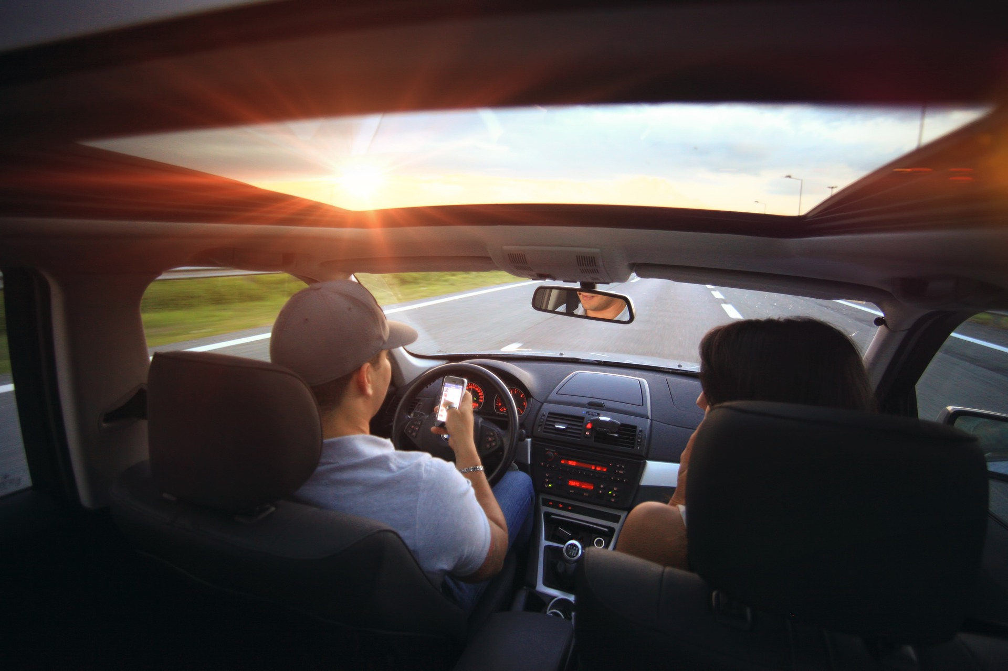
Who Listens to Radio Most?

Slide 21
Who Listens to Radio Most?
When you add up all listening you do to the radio during a typical weekday - even when the radio is just on in the background - about how many hours per day do you listen to the radio, all totaled?
 | 18-24 | 25-54
30 MINS - 1 HOUR | 27% | 15%
1-2 HOURS | 30% | 27%
2-3 HOURS | 19% | 24%
3+ HOURS | 24% | 34%
Radio is getting far more TSL from 25-54s than 18-24s. Even the 18-24s who are tuning into radio are not spending enough time.

Slide 22
Who Listens to Radio Most?
When you add up all listening you do to the radio during a typical weekday - even when the radio is just on in the background - about how many hours per day do you listen to the radio, all totaled?
 | WORK @ JOB SITE / HYBRID | WORK FROM HOME
3+ HOURS | 33% | 28%
KEY POINT: Not only is the commute crowd larger than the work from home crowd…commuters are 17% more likely to be heavy users of radio.

Slide 23
Who Listens to Radio Most?
When you add up all listening you do to the radio during a typical weekday - even when the radio is just on in the background - about how many hours per day do you listen to the radio, all totaled?
 | HAVE PARTICIPATED IN CONTESTS
30 MINS - 1 HOUR | 17%
1-2 HOURS | 28%
2+ HOURS | 62%
Nearly two out of three contest players are heavy users of radio.
We’ll have a deeper profile of contest takers in webinar #3.

Slide 24
Who Listens to Radio Most?
When you add up all listening you do to the radio during a typical weekday - even when the radio is just on in the background - about how many hours per day do you listen to the radio, all totaled?
 | CONTROL AUDIO CHOICE | NOT CONTROLLERS
30 MINS - 1 HOUR | 14% | 25%
1-2 HOURS | 27% | 29%
2+ HOURS | 59% | 46%
Those workers who control their radio choice listen more to radio. Reaching “work controllers” gives you an advantage.

Slide 25
Who Listens to Radio Most?
When you add up all listening you do to the radio during a typical weekday - even when the radio is just on in the background - about how many hours per day do you listen to the radio, all totaled?
 | TOTAL | HAVE RADIO APP
30 MINS - 1 HOUR | 17% | 9%
1-2 HOURS | 28% | 27%
2+ HOURS | 56% | 64%
Listener who have a radio station app use more radio.
We find that if a listener has your app, 60-70% will typically tune in daily.

Slide 26
What Workers Listen to by Location & Daypart
Home vs In-Car
Workplace vs Work From Home
Daypart Listening Patterns

Slide 27
Audio Listened To Most by Location
Please select which audio you listen to MOST in the following locations / situations.
Radio has the advantage over DSPs in the car and at the job site/office.
Local radio loses badly at home.

Slide 28
Audio Listened To Most: By Location
Radio is challenged in the offices and job sites, which is where local radio has enjoyed so much of its support.

Slide 29
Audio Listened To Most by Daypart
For each time, please indicate whether you typically listen to local radio often, once in a while, or never at that time.
The majority of listeners use radio in the morning and usage falls after 9am.
There is a big drop in listening among 25-54 from mornings through the rest of the day.
Radio needs to leverage that morning support through the day!

Slide 30
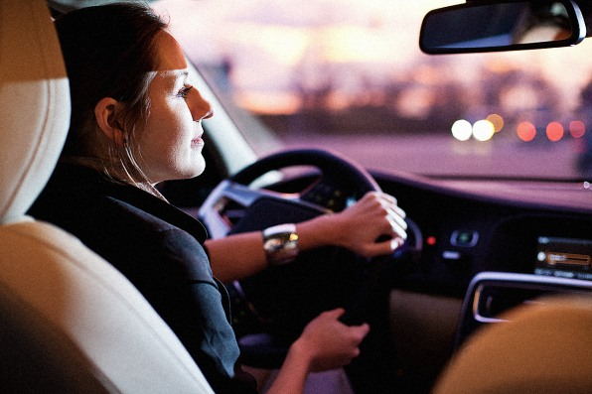
Profile of The Commute
Work Status
How They Travel
What They Listen To

Slide 31
Worker Profile
Eight out of 10 workers work fulltime.

Slide 32
Worker Profile
Winning the radio game requires wooing fulltime workers: Those who listen most to local radio are more likely to work full time.

Slide 33
Worker Profile
Most workers are commuting to a job site every day.

Slide 34
Worker Profile
The great majority of full time workers are driving themselves for their entire commute.

Slide 35
Audio Consumed Most While Commuting
Females
Males
Local Radio
DSPs
Local Radio
DSPs
Local Radio still has the largest share on the commute, but sizable shares are being stripped away by DSPs, particularly among Women.

Slide 36
Audio Listened To Most: While Commuting
What type of audio do you listen to MOST while commuting?
 | FULLTIME | PART TIME
LOCAL RADIO | 51% | 38%
STREAMING SERVICES (SPOTIFY, PANDORA, APPLE MUSIC, ETC.) | 29% | 38%
YOUR OWN MUSIC PLAYLIST | 8% | 14%
SIRIUSXM | 6% | 2%
PODCAST | 4% | 3%
KEY POINT: Radio receives a lot more support from Fulltime Workers than Part-timers while they commute.

Slide 37
Audio Listened To Most: Home/Car
Please select which audio you listen to MOST in the following locations / situations.
 | AT HOME | IN THE CAR
LOCAL RADIO | 21% | 62%
DSPs (Spotify, Pandora, Apple Music, etc) | 48% | 19%
SIRIUSXM | 2% | 9%
YOUTUBE | 22% | 4%
iHEARTRADIO APP /AUDACY /TUNEIN | 3% | 2%
PODCASTS | 4% | 3%
NONE | 4% | 2%
Radio’s support remains car-based.
Long term, radio has to become a bigger choice in the home.

Slide 38
Audio Listened To Most: Workplace/WFH
Please select which audio you listen to MOST in the following locations / situations.
 | WHILE WORKING FROM WORKPLACE | WHILE WORKING FROM HOME
LOCAL RADIO | 37% | 22%
SPOTIFY / PANDORA / APPLE MUSIC | 32% | 43%
YOUTUBE | 9% | 14%
iHEARTRADIO APP / AUDACY / TUNEIN | 5% | 3%
SIRIUSXM | 4% | 2%
PODCASTS | 3% | 4%
NONE | 10% | 12%
Radio no longer dominates workplace usage (!), but it gets more support there than among the WFH crowd.

Slide 39
Brand Engagement
Attractors
Potential Attractors
Engagement Levels: Radio vs Spotify

Slide 40
Brand Attractors for Radio
Which of the following would motivate you to listen MORE to local radio in the mornings 6am-9am? Select all that apply. (multiple choice)
There are big ways to drive more radio usage that are things radio does uniquely well.
Traffic is still important for one out of three.
Contests are a driver for one of five listeners.

Slide 41
Brand Attractors for Radio
Which of the following would motivate you to listen MORE to local radio in the mornings 6am-9am? Select all that apply. (multiple choice)
Contesting is an even bigger listening driver for Heavy Work Listeners and for those likely to participate in ratings.

Slide 42
Brand Attractors for Radio
Which of the following would motivate you to listen MORE to local radio in the mornings 6am-9am? Select all that apply. (multiple choice)
 | TOTAL | LIKELY RATINGS PARTICIPANTS | SPOTIFY CUME | USE DSPs MOST WHEN WFH
More Nonstop Music | 57% | 56% | 58% | 61%
Funny Content | 48% | 56% | 48% | 43%
Updates on Local Info & Events | 43% | 46% | 46% | 47%
A personality that is a great companion along with playing a lot of music | 34% | 39% | 37% | 38%
Traffic information | 33% | 35% | 36% | 35%
More from your favorite radio personalities | 24% | 29% | 26% | 26%
Contests | 18% | 25% | 17% | 17%
Notes:
Two of the top 3 brand attractors for morning radio are FUNNY and LOCAL.
Also important are hosts. Traffic is also still important for 1 out of 3.
Contests are a driver for one out of four likely ratings participants.
Contests also play a pivotal role in driving app downloads…more on that in our next webinar.

Slide 43
Engagement to Radio
How connected to you feel to each of the following?
Workers still feel more connected to their favorite local radio station than to Spotify. (opportunity!)

Slide 44
Engagement to Radio
How connected do you feel to each of the following
Even listeners of Spotify feel just as connected to their favorite local radio station as Spotify itself.

Slide 45
Engagement to Radio
How connected to you feel to each of the following?
Among 25-54 year-old workers, local radio has the advantage.

Slide 46
Engagement to Radio
How connected to you feel to each of the following?
25-54s feel more connected to their favorite station than Spotify, but 18-24s are more connected to Spotify.

Slide 47
Key Findings
Listeners perceive that they are listening more – we just need more credit!
Winning the radio game requires wooing Fulltime Workers:
Those who listen most to local radio tend to be FTW.
Fulltime Workers who commute are more likely to be heavy users of radio.
Local Radio still has the largest share of usage during the commute, but sizable shares are being stripped away by DSPs, particularly among Women.
Radio’s support is primarily car-based with the work site second.
Radio is losing badly to DSPs at home and among the WFH crowd.
Fortunately, the great majority of workers are back to commuting.

Slide 48
Key Findings
Local Radio’s support is strong 25-54 and leads DSPs by 2:1 35-54.
Radio still has growth opportunities 25-54 by doing a better job leveraging its strength in mornings to boost usage during the rest of the day.
Radio is still in the game among 18-24s; radio is at cume-parity with DSPs. The problem is a large segment of 18-24s are spending less time with radio.
Large numbers of 18-24s appreciate radio’s local focus and engaging hosts, which are strengths that radio’s competitors will find tough to mirror.
18-24s also appreciate that radio is free and also enjoy its ease of use.

Slide 49
Discussion Points
The medium should be promoting the key drivers of its current positive momentum: Free, quick and easy to use, local, enjoyable hosts.
The most efficient way to grow is in mornings and focusing on the most important drivers: Music, local info and funny content. Funny wins – period.
Your most immediate focus should be on fulltime workers who drive themselves to work – particularly those who control the radio at work.
Leverage the high radio use in mornings and the car to the office.
Look to use contesting in your marketing activities. Contesting drives greater usage.
Evaluate your community relations plan: How can your brand and hosts make a more visible impact?

Slide 50
In Our Next Webinar April 23 – 2pm EST
The Workday
Headphone / Earbud Usage
Bring Workers Back to Radio More Often
Apps

Slide 51
Want to Dive Deeper?
WhatWorkersWantStudy.com
PTPMarketing.com
StrategicSolutionsResearch.com

